Slide 1
Investigate potential fraudulent activities of Credit Card Transactions and develop a fraud detection model
Dataset Link: https://www.kaggle.com/datasets/kartik2112/fraud-detection

Slide 2
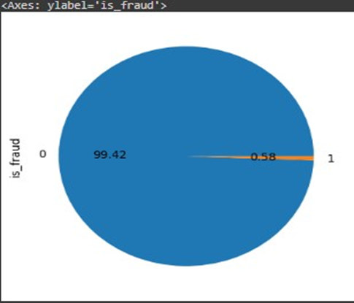
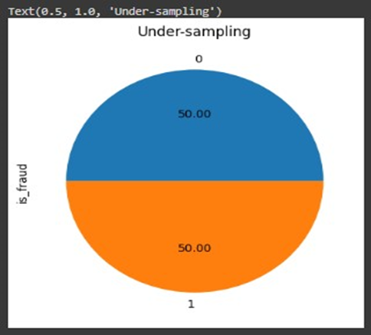

Data preprocessing
1. As the first step I had to manage the imbalanced data set.
when I studied the training dataset and test dataset, i found that the both data sets were imbalanced.
so I had to do preprocessing to balance both datasets using under-sampling techniques.

Slide 3
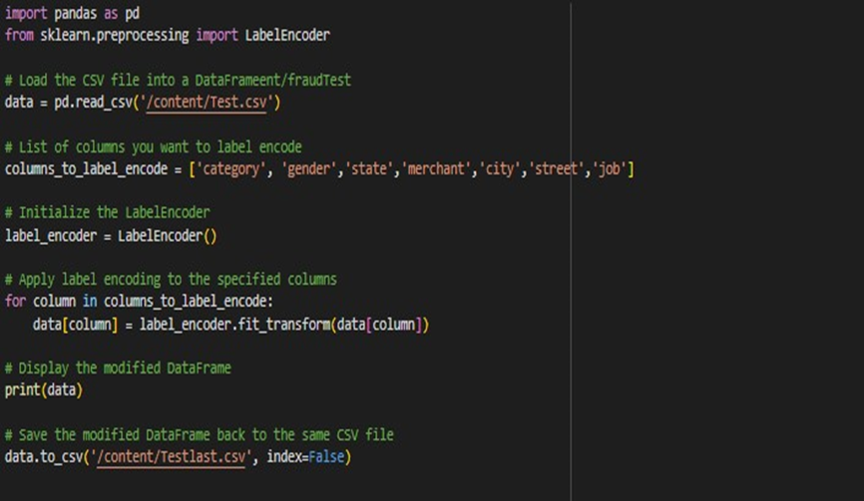
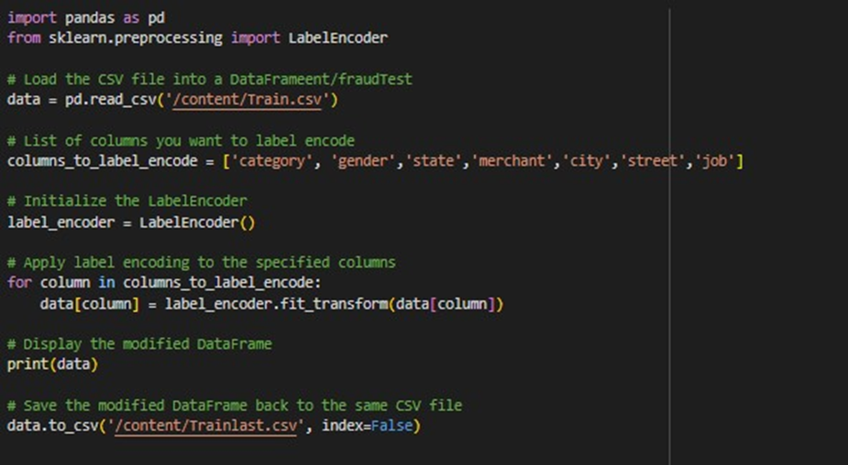
2. Then I converted the categorical variables of the dataset to numerical variables before feeding to the model.

Slide 4
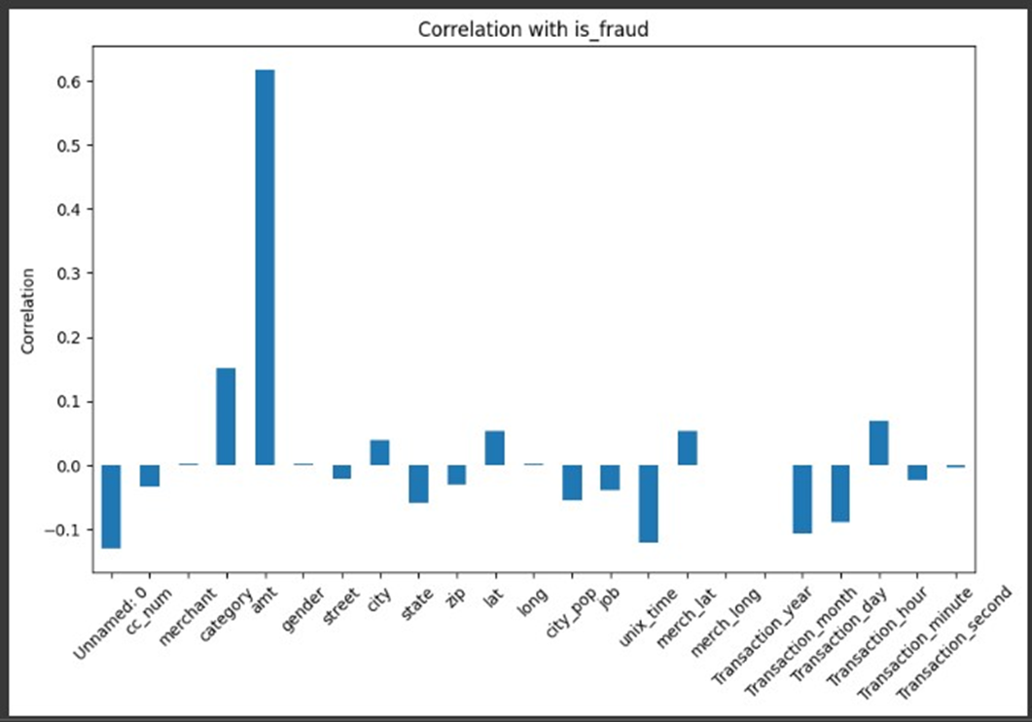
3. Then I did a correlation analysis to understand the relationship between the given variable with the target variable.

Slide 5
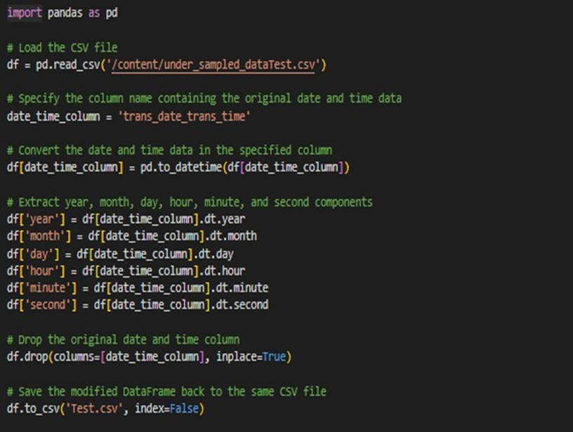
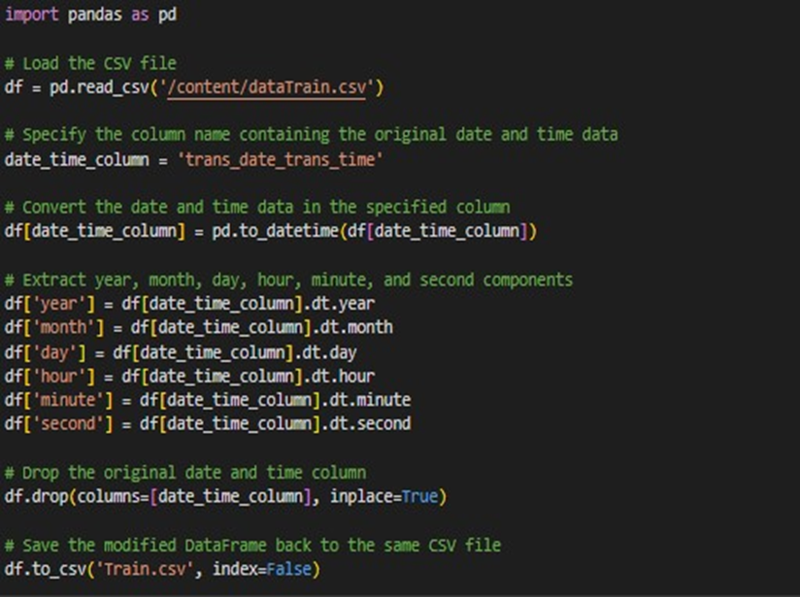
4. Then I dropped the unnecessary columns only keeping relevant data columns for the model.

Slide 6
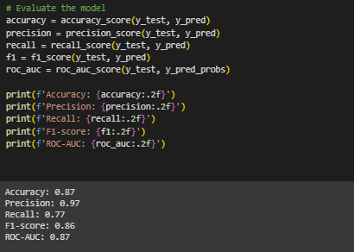
I built a MLP model for fraud detection and it ended up with following model's performance metrics
Model Building

Slide 7
Thank You

